Slide 1
Welcome to Art Class
Please have a seat where there is a stool. Don’t move them.

Slide 3
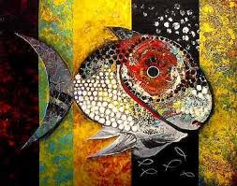
What is Art?

Slide 4
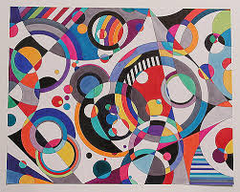
Duh. It’s this class you have to take

Slide 5
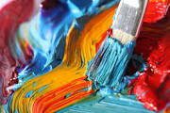
Art is…
The expression of human creative skill and imagination, typically in a visual form such as painting or sculpture, producing works to be appreciated for their beauty or emotional power.
Webster’s Dictionary

Slide 6
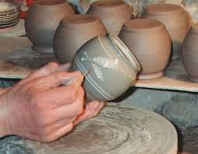
A quote…
The craftsman knows what he want to make before he makes it…
The making of a work of art … is a strange and risky business in which the maker never knows quite what he is making until he makes it.
-R.G. Collingwood

Slide 7
The rules, you have to know them.

Slide 8
Rule 1

Slide 9
Rule 3

Slide 10
Rule 2

Slide 11
Rule 4

Slide 13
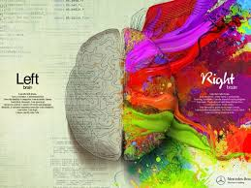
Come prepared…
A pencil
Your assignment notebook
A good attitude
Your creative brain

Slide 14
Pay attention but…

Slide 15
Help out!

Slide 16
Be nice to your teacher.

Slide 17
Grading
60% Class work
Worksheets
practice
art experiments
group work
40% Art projects
Drawing
Painting
Clay
printmaking

Slide 18
Skill Sheets
You must turn in:
6th grade: 3 per quarter (6 total)
7th and 8th Grade: 4 per quarter (8 total)

Slide 19
Remember

