Slide 1
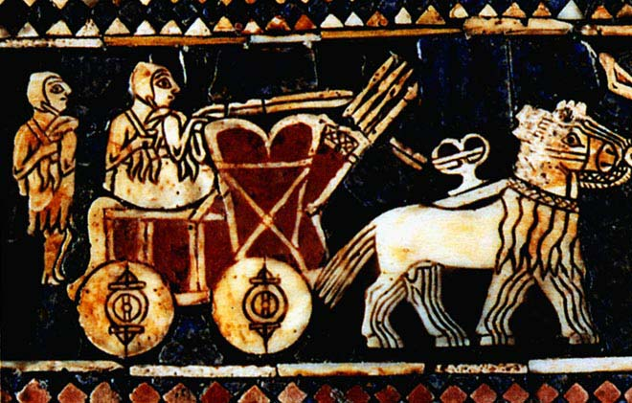
The Cultural Achievements of Sumer

Slide 2
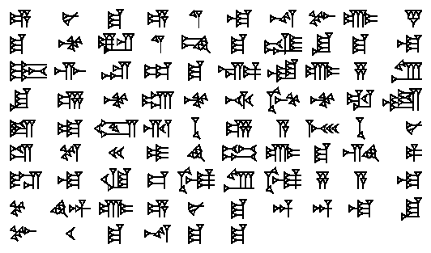
WRITING

Slide 3
The Sumerians used CUNEIFORM to make trade easier.
They wrote not on paper, but on clay tablets.

Slide 4
Originally the Sumerians had 2,000 symbols in the cuneiform alphabet. Over time they were able to reduce the number of symbols down to 700.
Why do you think the Sumerians eliminated symbols from their alphabet?

Slide 6
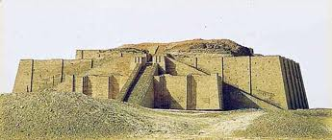
RELIGION

Slide 7
The Sumerians were polytheistic which means they believed in more than one god.

Slide 8
RELIGION
A religious system includes the
sets of beliefs, the GODS (and
GODDESSES !) and forms of
worship a civilization has.

Slide 9
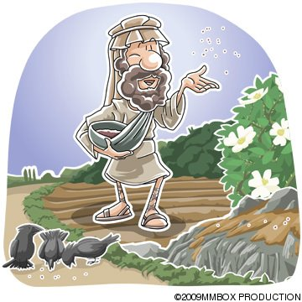
In Sumer, religious beliefs influenced every part of daily life. Sumerians tried to please the gods in all things from GROWING CROPS to settling disputes. Religion bound them together in a common way of life.

Slide 10
Ziggurats are the buildings and TEMPLES built by Sumerians to express their religious beliefs. They were very tall – people could see them from 20 miles away!

Slide 11
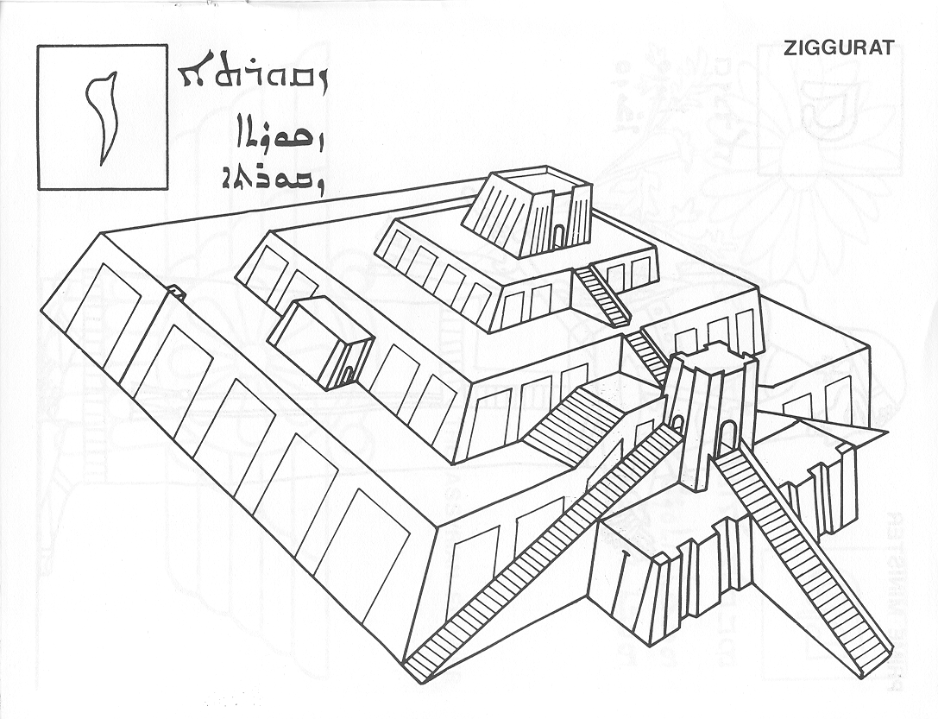
ZIGGURAT

Slide 12
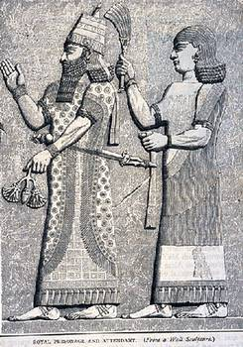
Who Lived in the Ziggurats?
The Sumerians believed that GODS lived inside the ziggurats. The built long staircases so they could climb down to earth. Kings and priests went inside the temples to ask the gods’ blessings.

Slide 13
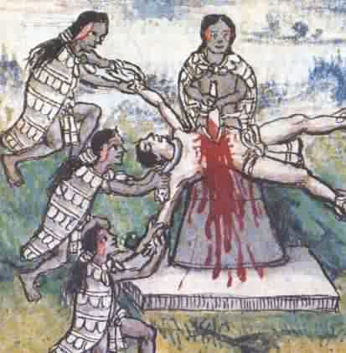
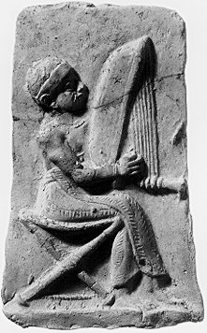
How Did Sumerians Show Their Devotion?
Sumerians had many kinds of religious ceremonies to show their dedication to the gods. These ceremonies could include MUSIC or HUMAN sacrifices.

Slide 14
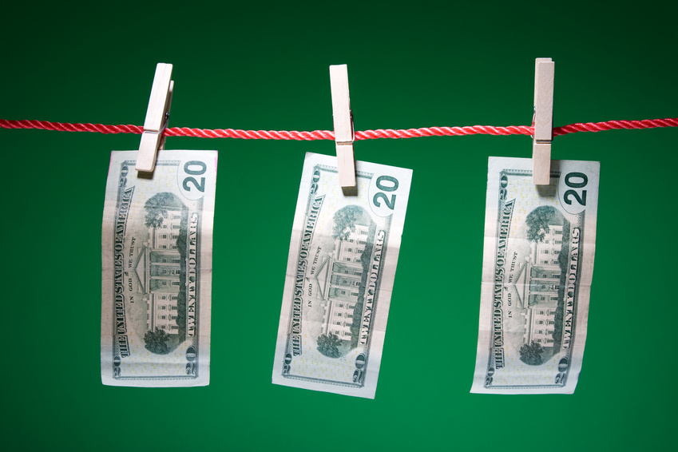
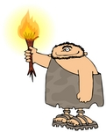
ECONOMY

Slide 15
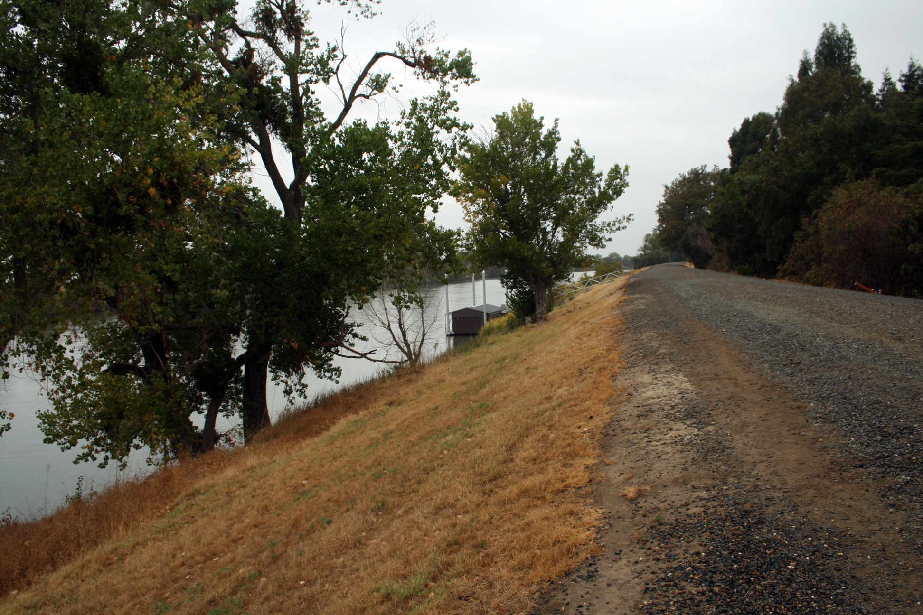
Traditional Economy – used bartering
Traded with other cities around the Persian Gulf
Traded for beads, jewelry, pottery, gold and silver
Used slaves

Slide 16

Vocabulary

Slide 17
Government

Slide 18
Intro to Government and Power

Slide 19
List all of the people who live in your house and how you are related to them (aunt, cousin, mom, etc.)
Who in your immediate family has the most power?
Why does that person have more power than anyone else?
What do they do with that power?
4. Who in the USA has the most power?
5. Why does that person have more power than anyone else?

Slide 20
Ancient Sumer Before Empires

Slide 21

Stop and Jot
Make a prediction about 2 challenges a leader of an Empire in Mesopotamia might face

Slide 22
Sumer 3500 BCE – 2350 BCE
Sumer was a lose collection of city-states
Each city state had its own ruler, known as a king of an Ensi

Slide 23
Each City State Had It’s Own
LAWS | FARMLAND | GOVERNMENT AND ARMY

Slide 24
The city-states shared a common LANGUAGE and RELIGON
They did not have much else in common!

Slide 25
Everyone disagreed about who was most powerful and who had rights to water and food.
The city-states of Mesopotamia FOUGHT a lot over resources and also for POWER.

